Slide 1
Bridging R Programming with Excel
The Future of Data Modeling
Michael Charara | CDW | LinkedIn | Portfolio

Slide 2
GitHub Repo for Everything!
https://github.com/netdevmike/CDW-R-Programming-with-Excel.git

Slide 3

About Me
Education
Bachelor in Biology with a Minor in Psychology
Bachelor in Computer Science - Software Engineering
Masters in Business Administration
Masters in Information Management Systems
Certifications
Master's Degree Certificates in Cybersecurity & Data Analytics
Multi-Cloud Certified Solutions Architect (GCP, AWS, AZURE), CCNA
HMS Certifications in Physiology, Immunology, Biochemistry, Genetics
Work Experience
Retail Chane manager- KFC, Pizza Hut, Tim Hortons
Research Assistant Autosomal Dominant Polyscitc Kidney Diseases
Network Administrator - Focused on Automation
Cloud Marketplace Program Manager

Slide 4

Agenda
Why R?
Learning Objectives
What is R?
What is R Studio?
Setup
Scripts

Slide 5

Why R?
Full of functions and features that will get you very far
Easy to learn for beginners
Built for people who do not code
Not used by experts
Often used by reaserchers
Few simple functions = alot of power
Most advanced statistics written into simple R functions
Advanced libraries to make graphs
Alot of tutorials online

Slide 6



WHO USES R?
Meta uses advanced tools like R programming for behavior analysis and social media analytics.
R is used in data management, data analytics, economic forecasting, and business-decision making at Google
Amazon data scientists and analysts use R for statistics and machine learning to build analytics systems that can measure the marketing ROIAverage Salaries for Amazon Employees

Slide 7
What is R?
R is a programming language for statistical computing and graphics.
It is the most popular statistical software in circulation today and is used by more than 2 million data scientists & and statisticians worldwide.
How Companies Use R to Compete in a Data-Driven World, data-informed.com
Downloard R! - https://cran.r-project.org/

Slide 8

What is R Studio?
IDE – Integrated Development Environment
Adds additional functionality e.g. git, shiny projects, markdown templates
R studio is the most popular IDE for R, although there are others, you don’t actually need it to execute R code.
R Studio sits atop the installed R version. Without base R, R Studio cannot function. By programmatically accessing base R, R Studio improves the interface and functionality.
Download R Studio! - https://posit.co/download/rstudio-desktop/

Slide 9
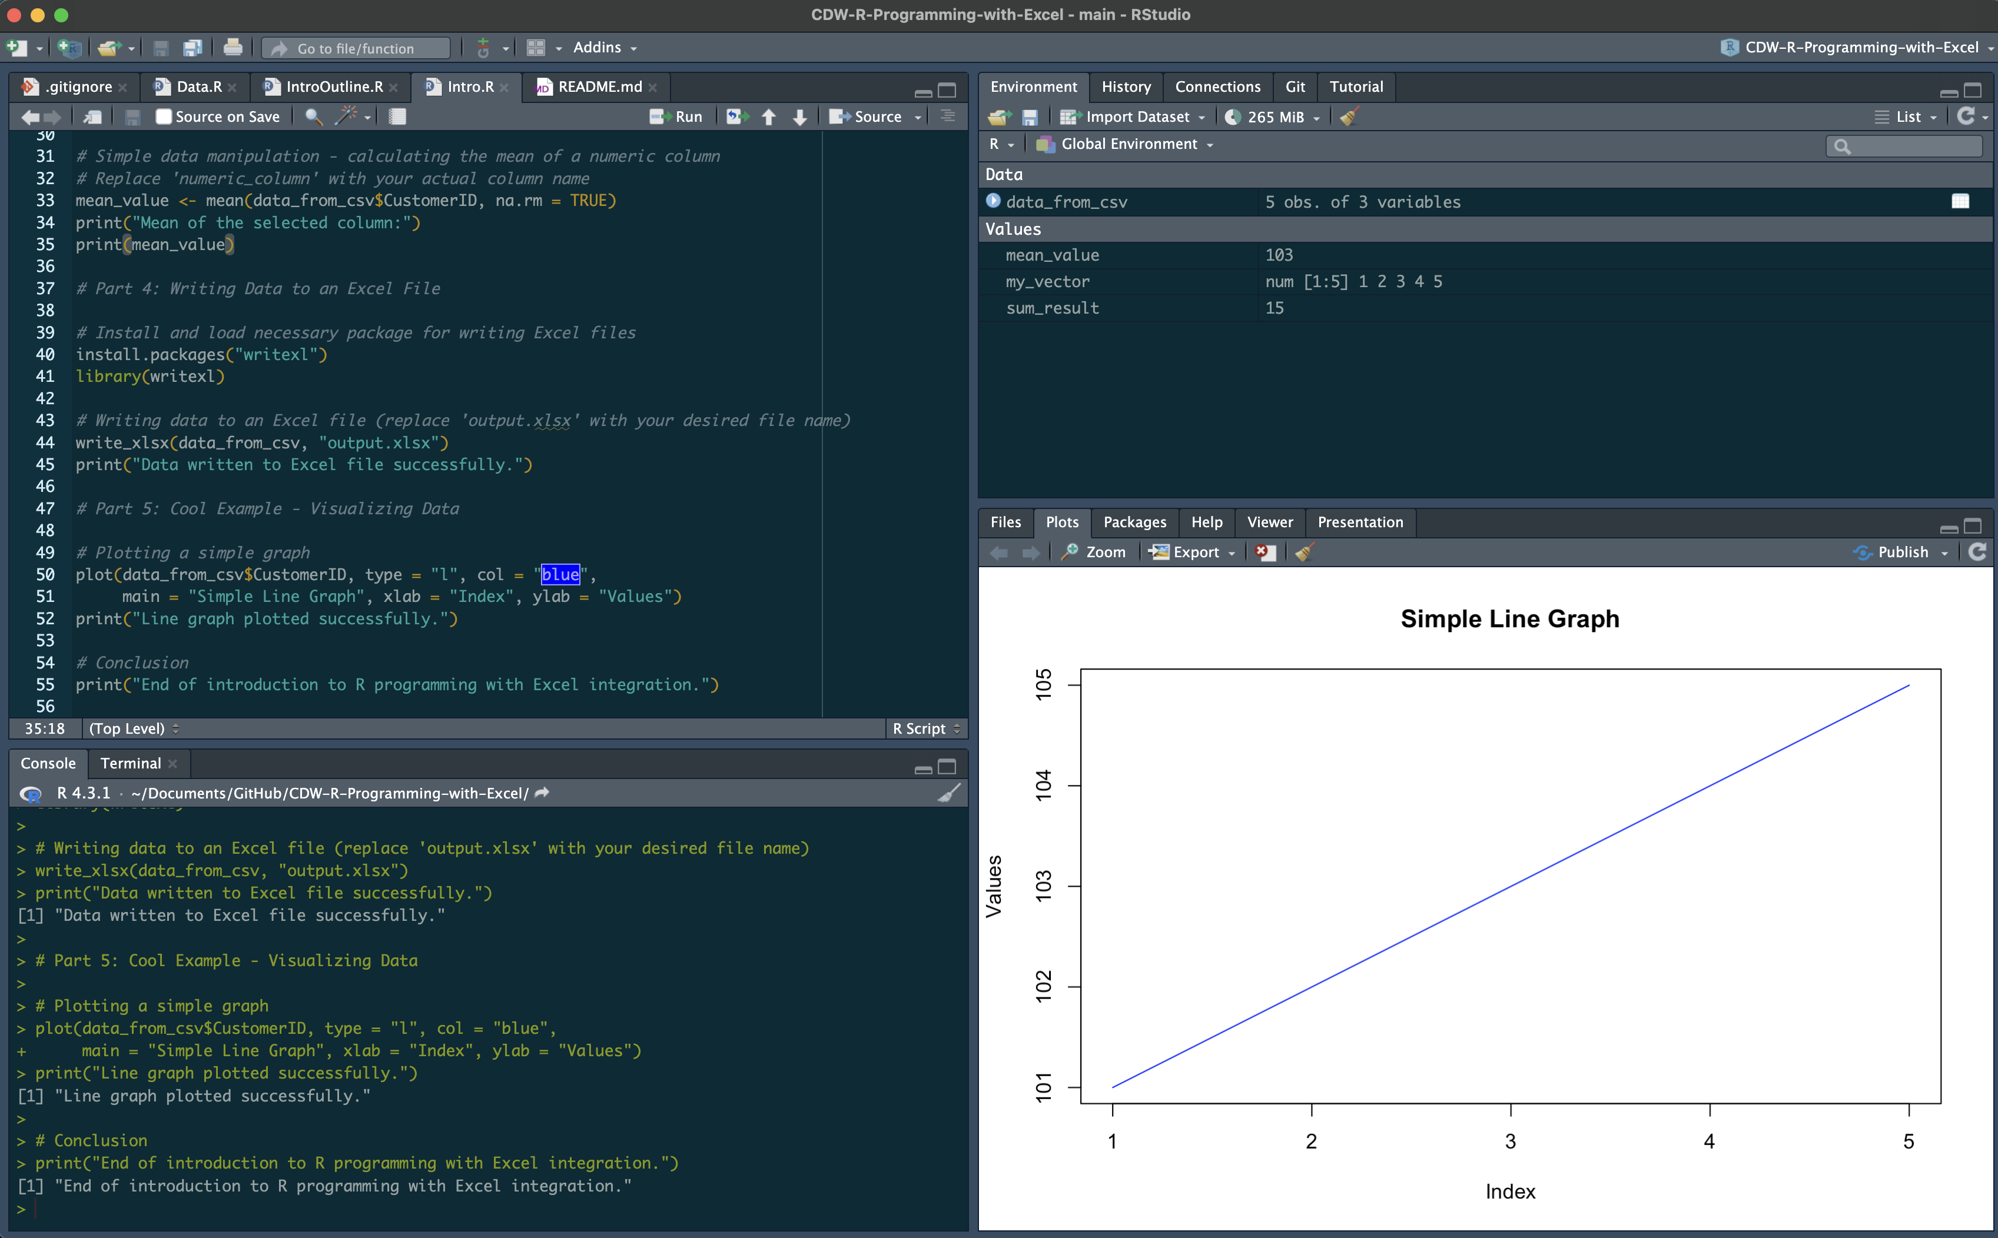
R Studio has four main panes
Code Editor
Environment
Console
Plot & Files

Slide 10

R Workflow
Let’s eat an apple for breakfast. Where is the fruit?
If a “local” file define the path to the file
setwd(‘fridge/shelf/fruits’)
OR
From a URL
csvFile <- ‘https://raw.githubusercontent.com/netdevmike/CDW-R-Programming-with-Excel/main/data/Customer_Data.csv?token=GHSAT0AAAAAACD2NM5HJUAQUG7JJJ7FN7AKZL2SGNA’
The item of interest needs to be in the “working directory”

Slide 11


R uses functions, libraries & objects
Found the fruit shelf! What tools do I need?
#setwd(“fridge/shelf/fruits”)
library(peel)
library(knife)
library(readr)
Change R into a breakfast-preparing machine with specialized libraries.

Slide 12
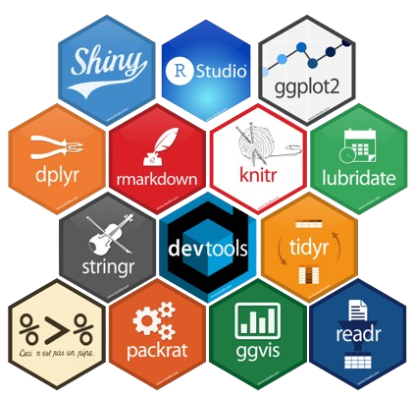
Lets build our tool box (libraries)
Before loading a library use
install.packages(“name of package”).
You only need to do this once per environment
But, you will need to repeat it w/each new environment!

Slide 13
R uses functions, libraries & objects
library(peel)
library(knife)
library(readr)
Now R is a cutting & peeling machine, let’s pick our fruit.
Fridge/shelf/fruits -> apple, banana, pear
setwd(‘fridge/shelf/fruits’)
apple <- readr(“Apple.”)
peelApple <- peel(apple)
cutApple <- knife(peelApple)

Slide 14
LETS CODE!

